Slide 1
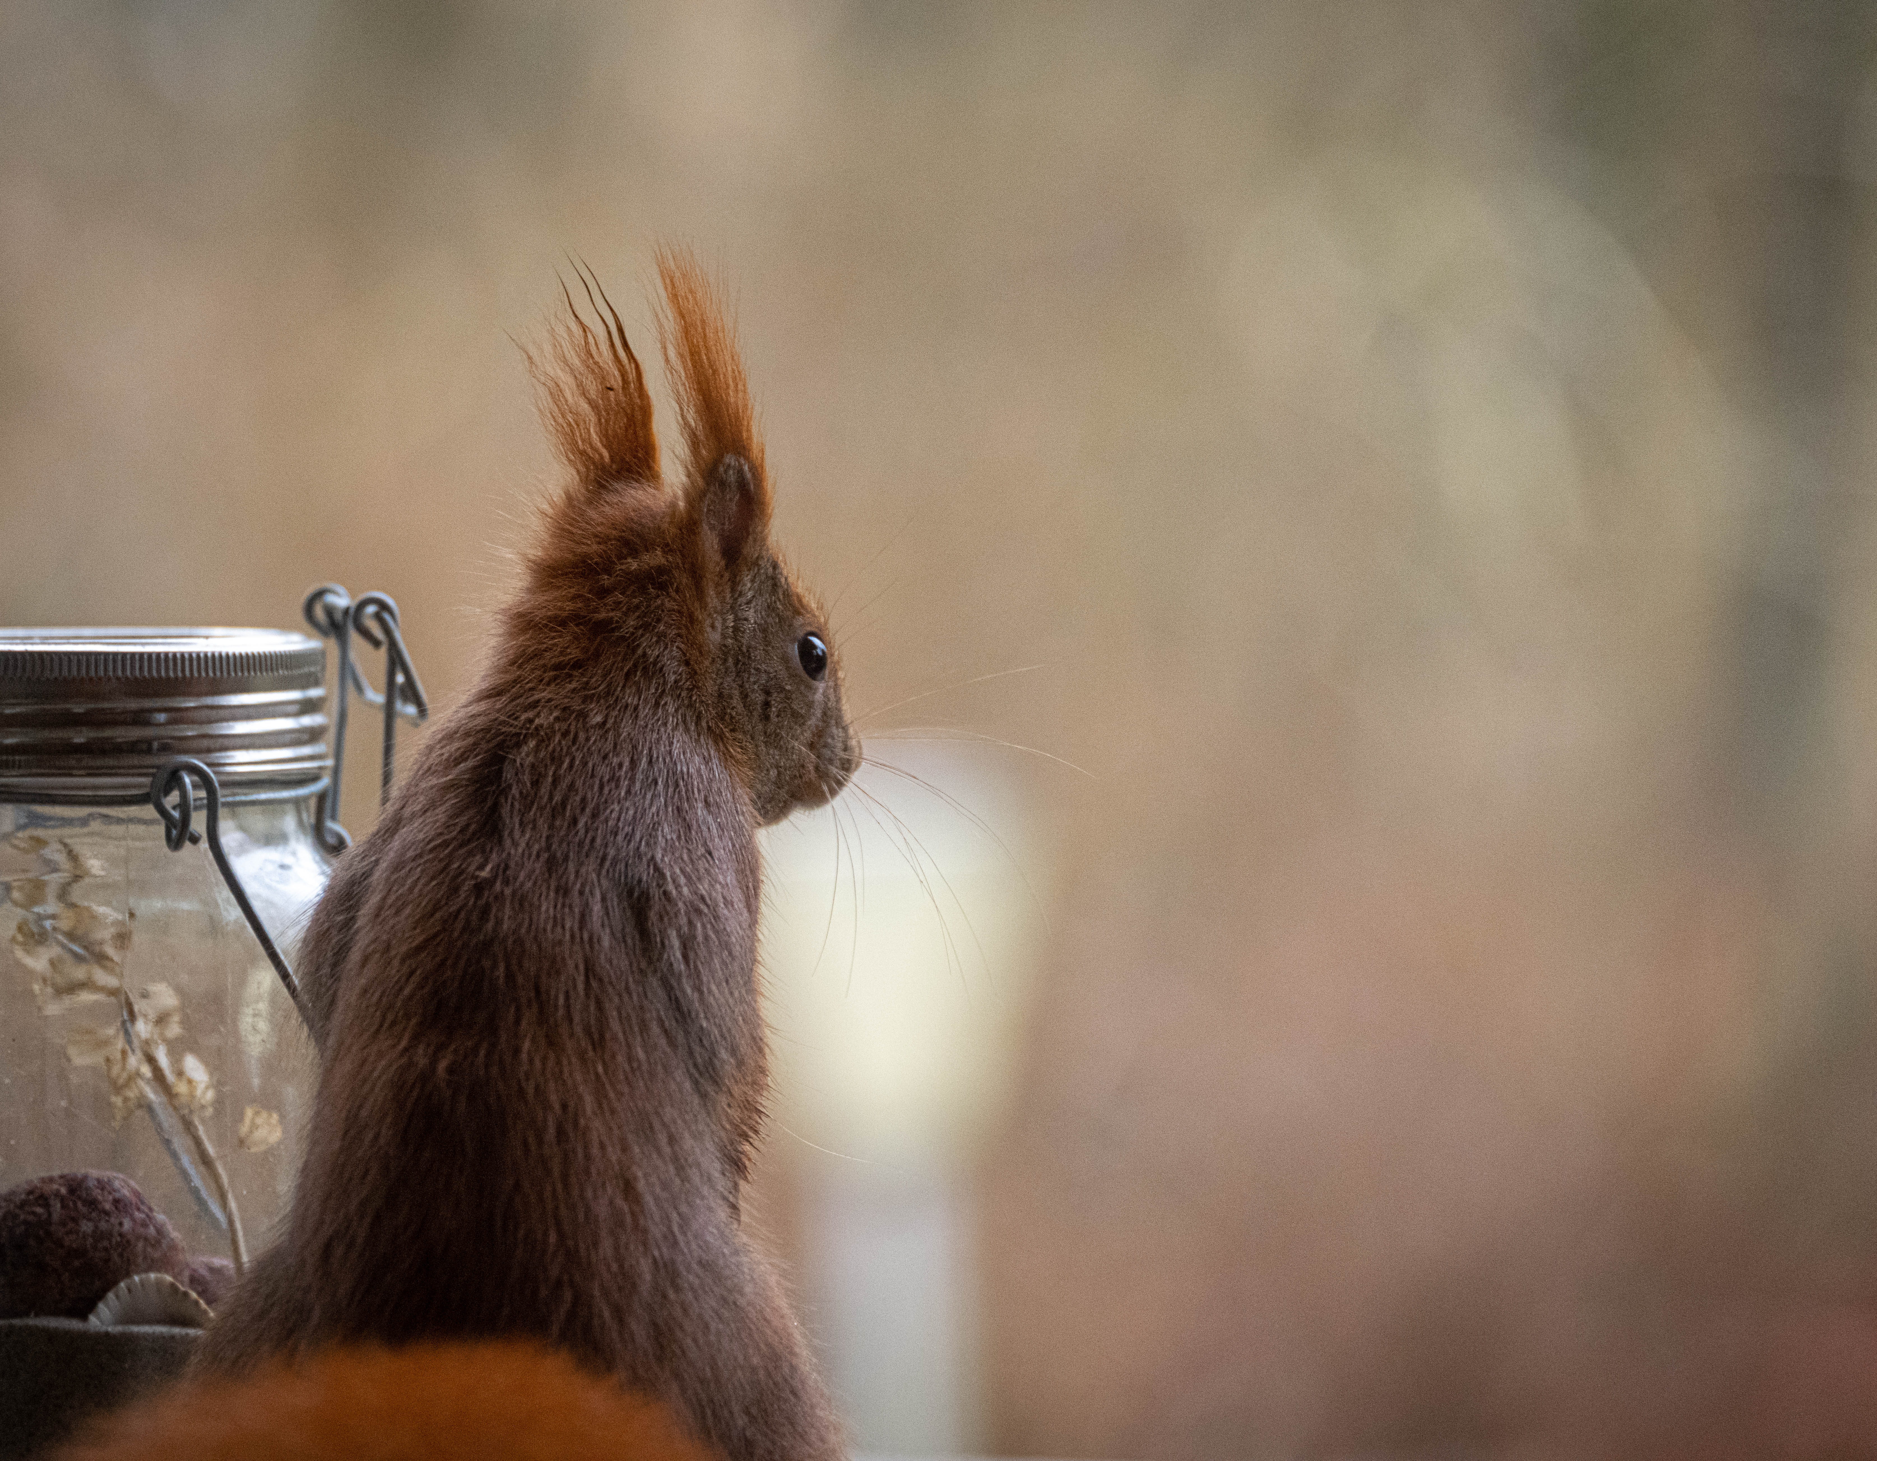
GraphQL Galaxy, online | Dec 8-9 2022 | @nilshartmann
NILS HARTMANN
https://nilshartmann.net
GraphQL
Subscriptions
with Kafka and Debezium
Slides (PDF): https://graphql.schule/wjax2022-gql

Slide 2


https://nilshartmann.net
NILS HARTMANN
nils@nilshartmann.net
Software Developer, Architect and Coach from Hamburg
Java, Spring, GraphQL, TypeScript, React
https://graphql.schule/video-kurs
https://reactbuch.de

Slide 3
A GraphQL API
type Customer { id: ID!
name: String! address: Int
}
type Mutation {
addCustomer(input: AddCustomerInput!): Customer!
}

Slide 4
A GraphQL API
type Customer { id: ID!
name: String! address: Int
}
type Mutation {
addCustomer(input: AddCustomerInput!): Customer!
}
type OnNewCustomer { newCustomer: Customer! }
type Subscription { onNewCustomer: OnNewCustomer! }

Slide 5
A simple use-case

Slide 6
A simple use-case

Slide 7
A simple use-case

Slide 8
A simple use-case 🤔

Slide 9
A simple use-case 🤔

Slide 10
A simple use-case 🤔

Slide 11
A simple use-case 🤔

Slide 12
A simple use-case 🤔

Slide 13
A simple use-case 🤔
😊
😢

Slide 14
Message Broker

Slide 15
Message Broker

Slide 16
Message Broker

Slide 17
Message Broker
😊
😊

Slide 18
Apache Kafka – https://kafka.apache.org

Slide 19
Apache Kafka – https://kafka.apache.org

Slide 20
Apache Kafka – https://kafka.apache.org

Slide 21
Apache Kafka – https://kafka.apache.org

Slide 22
Apache Kafka – https://kafka.apache.org

Slide 24
Adding a database...

Slide 25
😢
😢
Adding a database...

Slide 26
Adding a database...

Slide 27
😢
😢
Adding a database...

Slide 28
Change Data Capture (CDC)

Slide 29
Change Data Capture (CDC)

Slide 30
Debezium – https://debezium.io

Slide 31
Debezium
CHANGE EVENT IM DETAIL

Slide 32
Debezium

Slide 33
Debezium
😊
😊

Slide 34
Demo
😊
😊
https://graphql.schule/galaxy-example

Slide 35
Debezium
Summary mit Ausblick: K + DBZ für DB Read Model

Slide 36

HTTPS://NILSHARTMANN.NET | @nilshartmann
Thanks a lot!
Slides: https://graphql.schule/galaxy-2022 (PDF)
Source-Code: https://graphql.schule/galaxy-example
Contact: nils@nilshartmann.net

